Slide 1

AWS DATA ENGINEERING VIRTUAL INTERNSHIP
by
D.BHAVYA
Roll No. 214G1A3208
Department of Computer Science and Engineering (Data Science)
Srinivasa Ramanujan Institute of Technology
(Affiliated to JNTUA & Approved by AICTE) (Accredited by NAAC with ‘A’ Grade & Accredited by NBA (EEE, ECE & CSE)
Rotarypuram Village, B K Samudram Mandal, Ananthapuramu – 515701.
2024 - 2025

Slide 2

Contents
Course Objective
Introduction
Tools
Data processing methods
Roles and Responsibilities
Applications and Use Cases
Advantages and Disadvantages
Queries

Slide 3
Course Objective
The AWS Data Engineering course teaches you how to build and manage data systems using AWS tools. You'll learn to collect, store, and analyze data to help in making smart business decisions.

Slide 4

Introduction
AWS DATA ENGINEERING:
AWS data engineering involves using Amazon Web Services (AWS) tools and services to collect, store, process, and analyze data.
Data Engineers:
Data Engineer need to have a working knowledge of software engineering and database management. Data engineers design, build and maintain massive data base that support web applications or other digital services.
AWS data engineers perform the same duties as regular data engineers but exclusive to Amazon Web Services cloud platform

Slide 5





Tools
Key components and services:
Key components and services used in AWS data engineering include:
Amazon S3 (Simple Storage Service): For scalable storage of data.
Amazon RDS (Relational Database Service): Managed relational database service.
Amazon DynamoDB: NoSQL database service.
AWS Glue: Managed ETL (Extract, Transform, Load) service.
Amazon Redshift: Data warehousing service

Slide 6
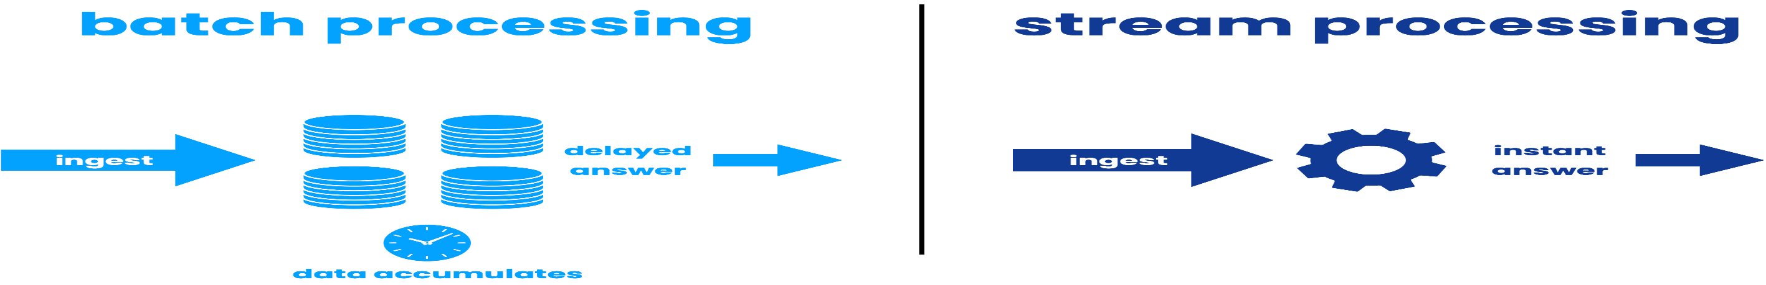
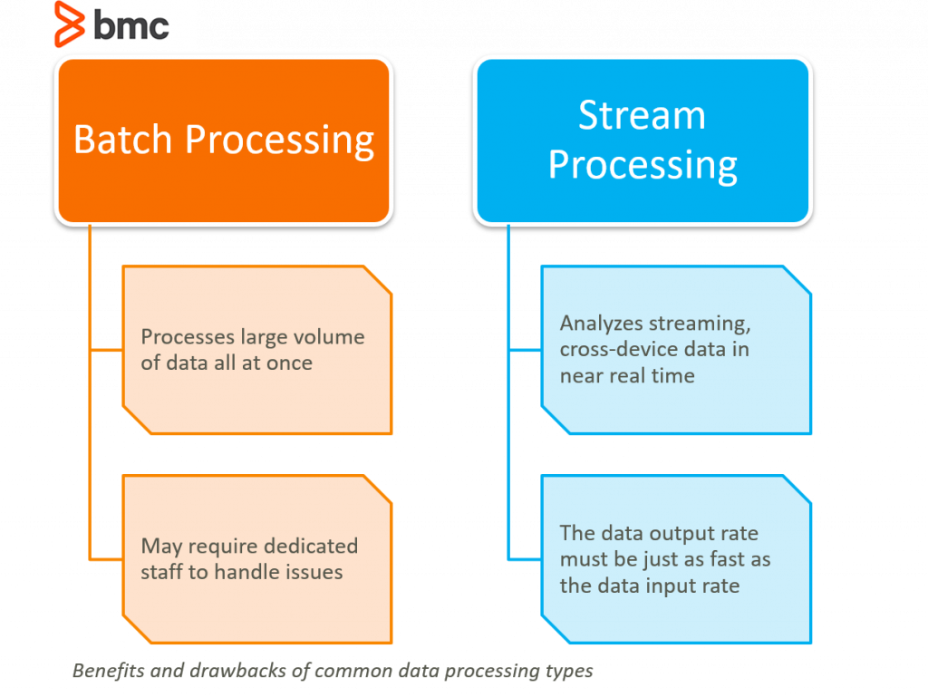
Technology
Data Processing Methods

Slide 7
Roles and Responsibilities
Roles and Responsibilities:
AWS data engineers have a variety of roles and responsibilities:
Constructing data models that may be utilized to gather information from numerous sources.
Researching new technologies and data sources that can be used in projects currently being worked on.
Finding patterns or insights in data that may be utilized to inform business choices or build strategies.
Making improvements to the infrastructure to increase storage capacity or performance.
Building data pipelines and handling large datasets.
Using AWS tools to integrate data.

Slide 8
Applications and Use Cases
Applications:
Storage and Backup
Social Networking
Mobile Apps
Gaming
Enterprise IT
AWS Use Cases:
Netflix
McDonald’s
Samsung
Facebook

Slide 9

Advantages and Disadvantages
AWS Advantages:
User-friendly
Flexible
Secure
Cost-effective
Disadvantages of AWS:
Limitations
Lack of Experts
Price Variations
General Issues

Slide 10
Any Queries?

Slide 11
Thank You!!!

